Slide 1
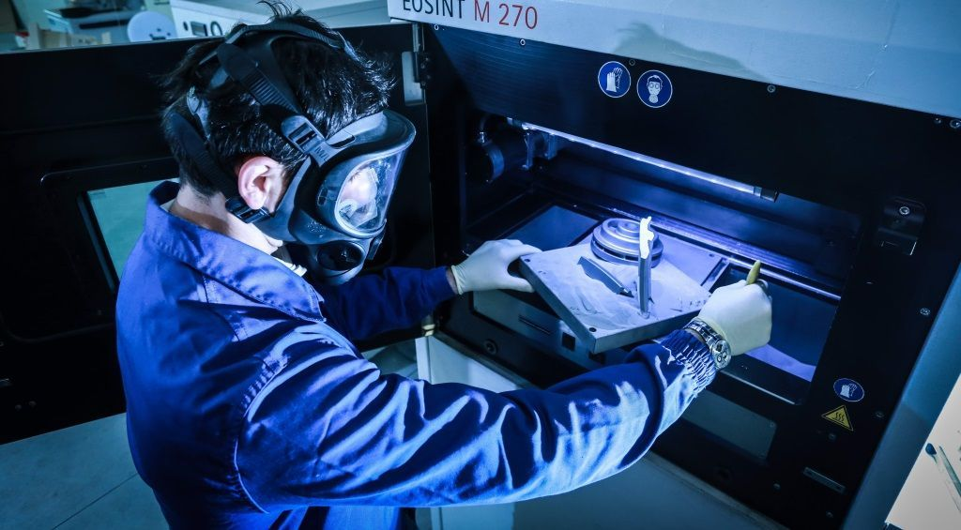
SANDRO DE POLI
CHAIRMAN @AVIO AERO
The additive manufacturing in Avio Aero – a GE Aviation business

Slide 2
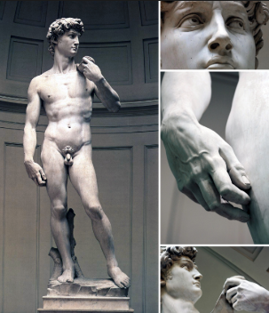
Michelangelo Buonarroti said that his David was already present inside the marble block. It was just matter to remove the excess material.

Slide 3
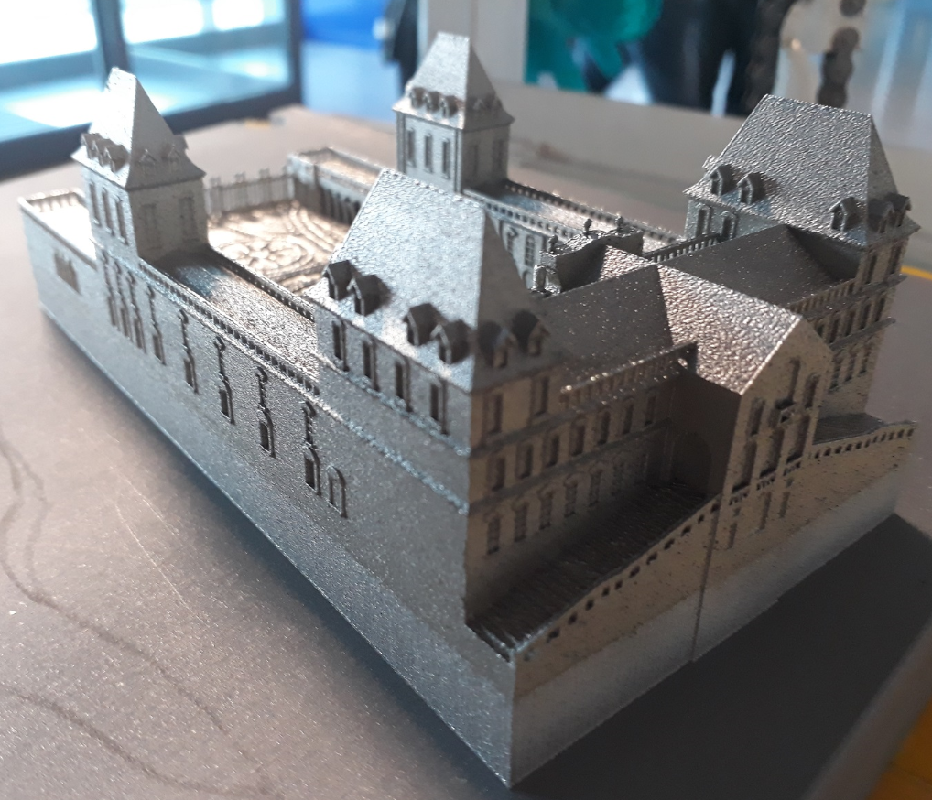
Additive Manufacturing
Michelangelo Buonarroti said that his David was already present inside the marble block. It was just matter to remove the excess material.
With Additive Manufacturing, we don’t speak about removing material but to add material exactly where necessary.

Slide 4
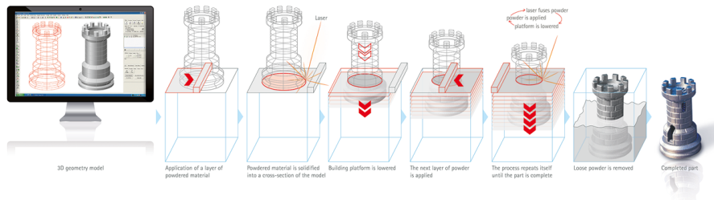
How Additive Works
Better, lighter, cheaper parts and systems
Integration of Complex functions (Complex geometries and features, internal passages)
Weight reduction (material only where needed, variable density, lattice)
Part simplification / Cost reduction e lead time reduction (multiple parts built as one)
Development time reduction /more freedom on redesign (no tooling needed)
Green process (waste and energy consumption, emission reduction)
New materials and geometries manufacturing (supplier monopoly disruption)

Slide 5
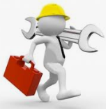
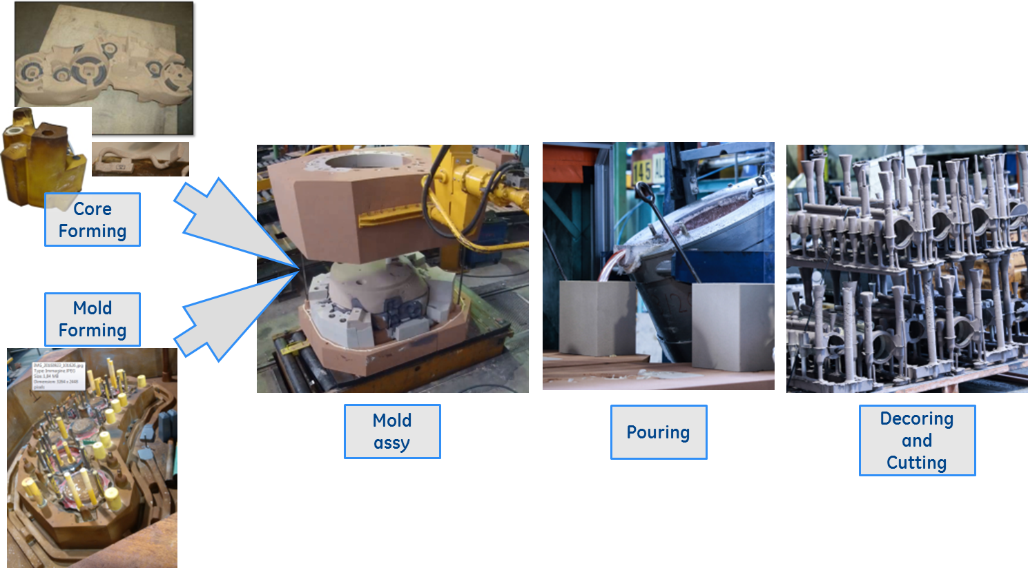
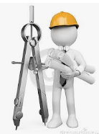
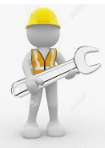
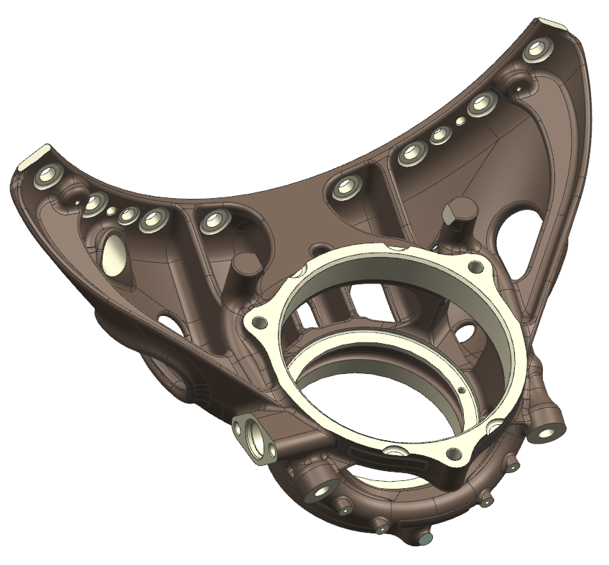
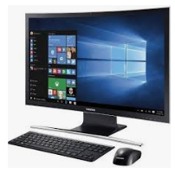
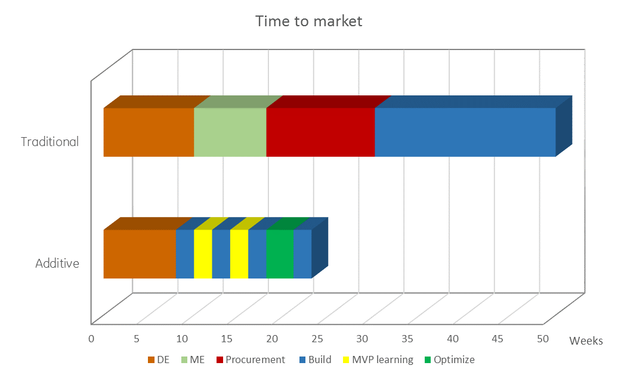
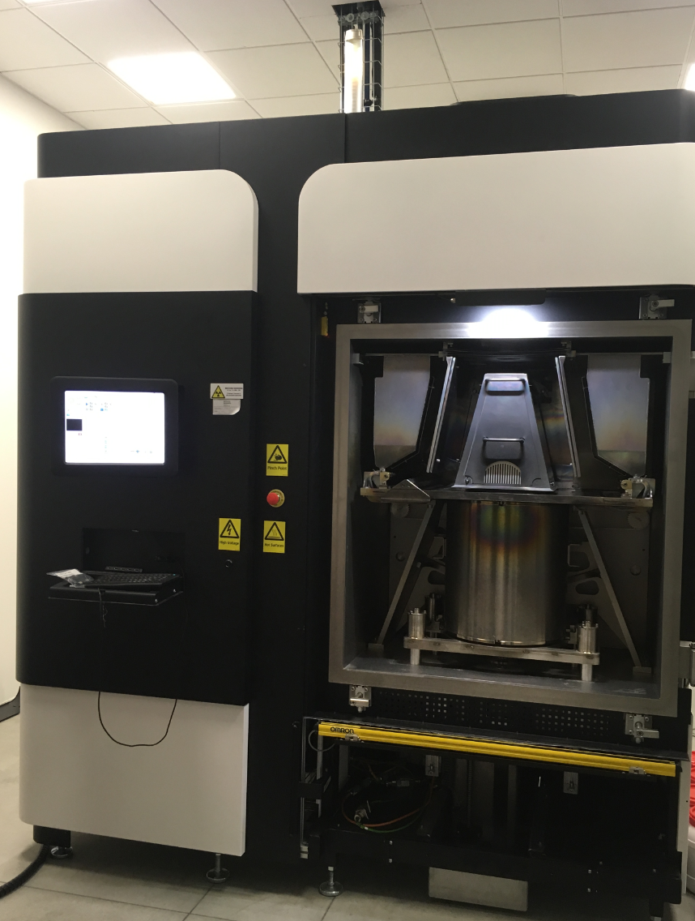
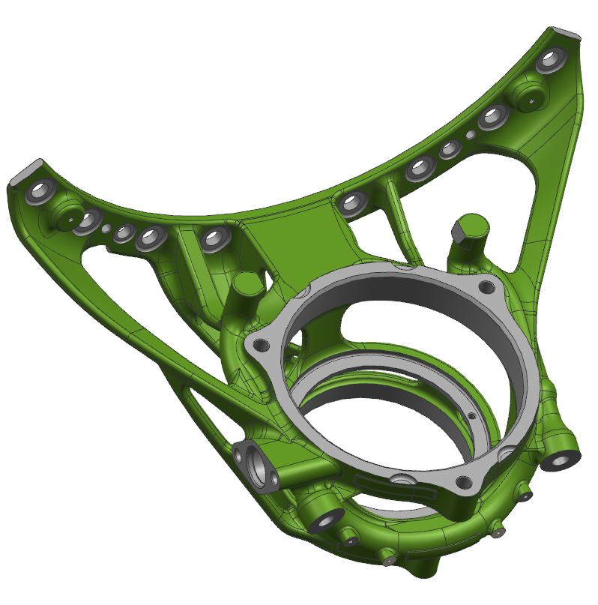
2 process in comparison - flow
Fixtures for mold
Fixtures for cores
Traditional process
Kalmin
Design Eng
Manufacturing Eng
Chillers
Sourcing / Supplier
Additive Manufacturing
Design Eng
Manufacturing Eng - Shop
AM process allows faster process optimization with significant cycle time reduction.

Slide 6
2 process in comparison - Persons
Design Engineer
Manufacturing Engineer
Shop Operator
Traditional Process
Additive Manufacturing

Slide 7
Addittive Manufacturing - Persons
Few manual actvities (from 50% to 5%)
Faster training on the job (about 3 months vs 3 years for foundry)
Creative Design (12 parts in AM Vs 855 traditional in Catalyst)
Pioneer in new material utilization (200 Kg less in GE9X)
Expert of the process y = f(x)
Analytic skill (data lake)
Additive Manufacturing
Design Engineer
Shop Operator
Manufacturing Engineer
With AM, Training and Collaboration with Univerities and Schools are crucial for the Success.

Slide 8















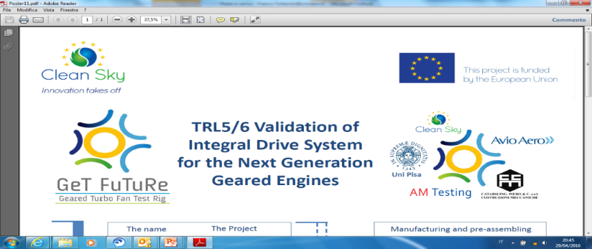

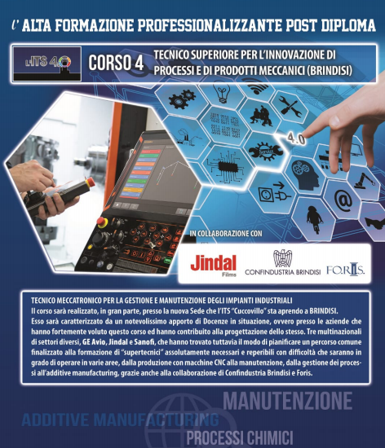

Avio Aero Consolidated Experiences….
Specific Master Degree
(PoliTo, UniSalento, PoliBari,
Federico II)
Masters Degree in ADVANCED MANUFACTURING
2nd Level Masters:
SYSTEM OF PROPULSION
ADDITIVE MANUFACTURING PoliTo and PoliBari
MANUFACTURING 4.0
MEAP – Manufacturing Engineer Academy Program
Technical & Soft Skills Seminars
Internships Projects
Thesis Catalogue
Research Labs
ARDC
Apulia Repair Development Center
Post Diploma (2 years):
Additive Manufacturing
Robot
Maintenance
Manufacturing process
Secondary School
More than 1000 students in “Alternanza Scuola Lavoro” project

Slide 9
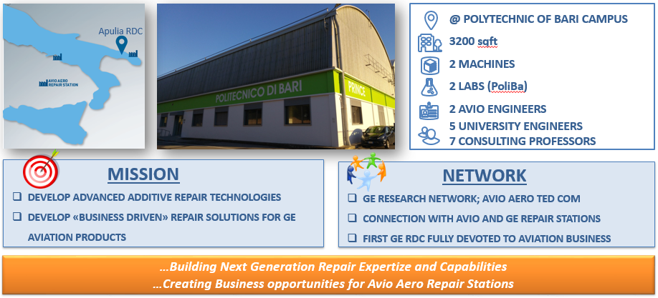
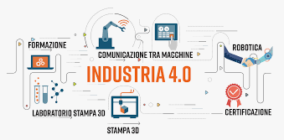
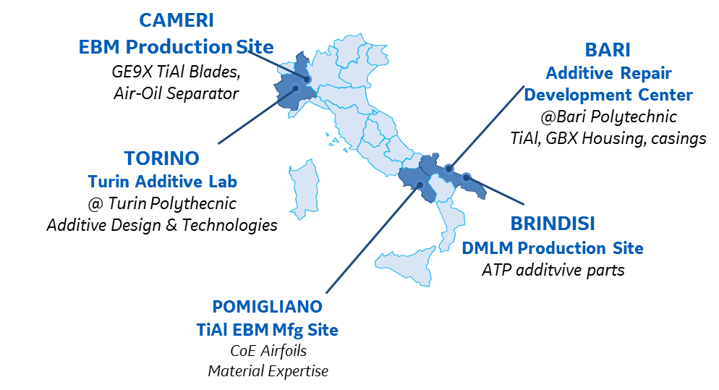
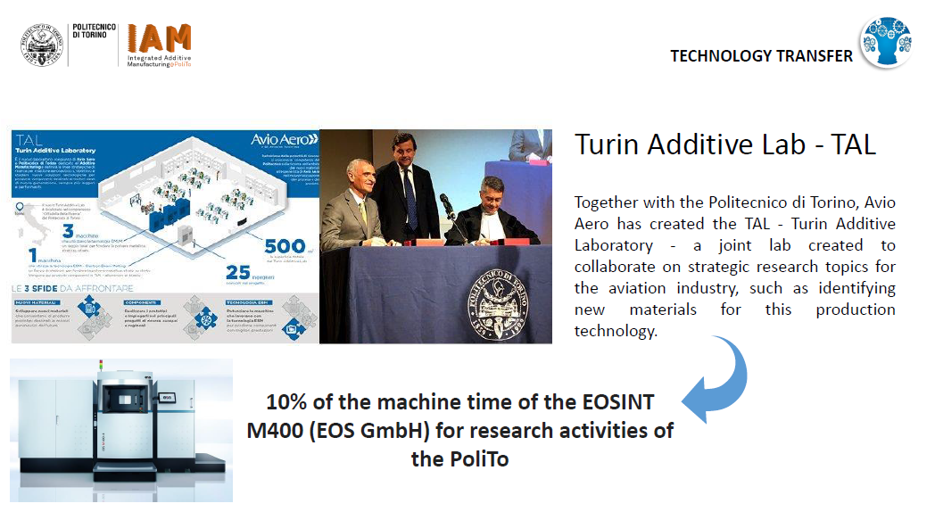
Avio Aero Additive Eco-System…
Within
Industria 4.0 Initiative
Close Collaboration
with the new GE additive business
GE Additive
World leader in EBM TiAl production, EU leader in AM aeronautical production

Slide 10


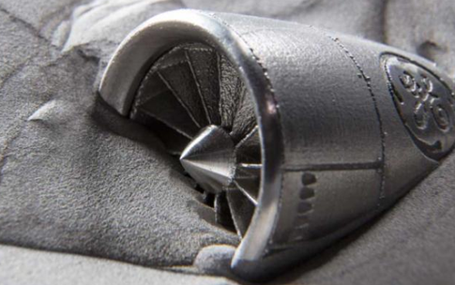






Human impact in global market…
New skills and workforce
Cost of the product less dipendent from workforce
$
Supplier monopoly disruption
65% of future’s jobs have not invented yet
70% of value of traditional blades is created in USA Vs 90% of valure created in Italy for GE9X
Delocalization to Low Cost Country is not anymore necessary. In the opposite, it is much more usefull relocate where there are compentences and know how.
PEOPLE
LOGISTIC
Interconnection and remote monitoring of the plant
Simplified logistic and travelling worldwide
Plants will be interconnected and monitored/controlled by remote
Plants can be smaller and specialized, so will located where the parts has to be used (assembly line).
Work life balance
People is not anymore tied for all the life to the same job/company/city but is ready to change for a bettere work life balance.
Stock and inventory management
ENVIRONMENT
Spare parts will be printed directly where necessary – no stock spare parts.
Gender gap reduction
New skills and new cleaner shop environment will be much more confortable.
Green technology
1/3 of energy is required for production,
With lighter components and less fuel comumption

Slide 11
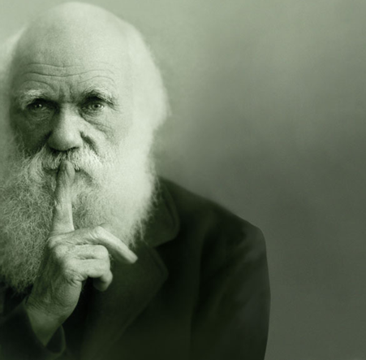
Conclusion
We don’t know where Additive Manufacturing will bring us and how it will transform the Industry…
What we know is that this phase of Digital Darwinism is a new industrial revolution and…
WE ARE PLAYING THE PATH FINDER ROLE.
It is not the strongest of the species that survives, nor the most intelligent that survives.
It is the one that is the most adaptable to change.
Darwin

