Slide 1


Renewable energy/Hydrogen
Brussels, 27 February 2019
Dr. Walter Huber

Slide 2
Focus on the global problems
Climate change needs technologies without greenhouse gases:
No CO₂, no CH₄, no toxic elements, no excess heat production
Renewable energy sources ⇒ basic electricity 24 hours available
  Storage of excess electricity production for short and long time periods
Mobility is a basic need ⇒ new thinking ⇒ new orientation !!
  Abandon fossil fuels: electric propulsion is the only solution!
  Change of traffic logistics: individual traffic ⇒ public traffic solutions
Globalism must be supported (not substituted !) by regionalism
  Renewable energy production and supply on regional and local basis
Recycling: is the big challenge = save raw materials
  Lithium batteries can not be recycled today (may be in the future?)
Hydrogen offers efficient solutions to most problems
Notes:
Climate changing is the great challenge for our future, it can be resolved only with the combination of: versatile thinking + know-how + better/efficient/new techniques without emissions and without excessive use of raw materials
The challenge: leave the fossil fuels or at least reduce It – internal combustion engine has reached its end of development – electric propulsion is the only solution which must be promoted
Renewable energies have only intermitted production – but we need 24 hours availability – intermediate storage is required – hydrogen as storage of excess renewable production offers the most efficient possibilities for short and longtime storage in every dimension
Globalism is like a tend extended over all of us, but has anyway have to be supported by pilasters – these pillars are is the regionalism, not to be against globalism, but to activate its benefits for all.
Recycling means introduce new efficient economies for used materials, means activating ‘urban mining’, means reduce the impact to overuse row materials and environmental impact.

Slide 3
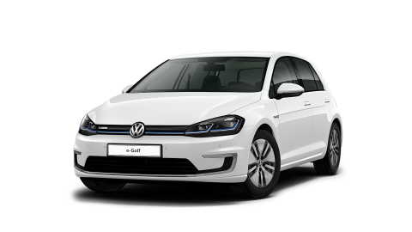
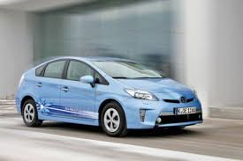
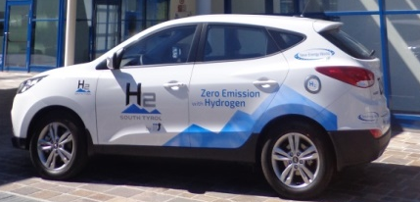
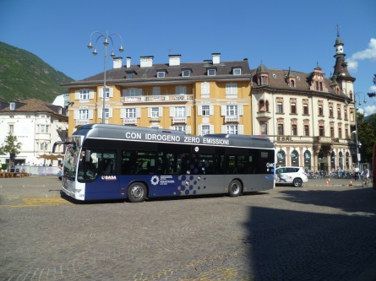
The role of hydrogen
Renewable energies
Electromobility
Battery electric vehicle
Hydrogen
Hybrid car
Electricity storage
Grid stabilization
Fuel cell hydrogen
Electricity storage for long periods:
renewable electricity becomes
available 24 hours
Fuel cell electric vehicles
Notes:
Climate changing is the great challenge for our future, it can be resolved only with the combination of: versatile thinking + know-how + better/efficient/new techniques without emissions and without excessive use of raw materials
The challenge: leave the fossil fuels or at least reduce It – internal combustion engine has reached its end of development – electric propulsion is the only solution which must be promoted
Renewable energies have only intermitted production – but we need 24 hours availability – intermediate storage is required – hydrogen as storage of excess renewable production offers the most efficient possibilities for short and longtime storage in every dimension
Globalism is like a tend extended over all of us, but has anyway have to be supported by pilasters – these pillars are is the regionalism, not to be against globalism, but to activate its benefits for all.
Recycling means introduce new efficient economies for used materials, means activating ‘urban mining’, means reduce the impact to overuse row materials and environmental impact.

Slide 4


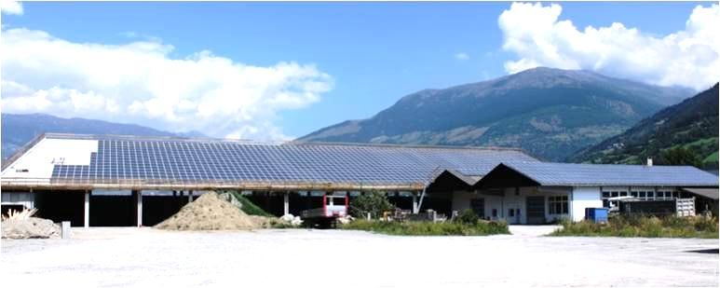
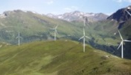


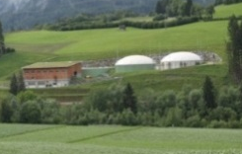
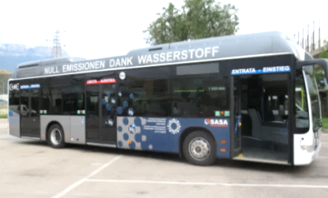

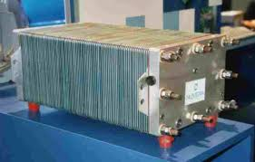
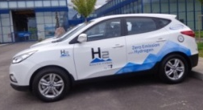
Storage of renewable electricity
Renewable energies
Electricity production
Public grid
Need in public grid
Re-electrification
Excess
H₂
Excess
storage as hydrogen
Public services, private mobility, refueling stat.; industry, SME;
without emissions
House techniques, application of all types, stationary units
Stabilizing the public grid, peak electricity, renewable energy available 24 hours,
independency
The excess of electricity: use it – not loose it !
Notes:
There are three big areas of technical hydrogen applications.
The mobility stays in the focus of public attention, the function as grid stabilizator will become at least as important as the mobility sector – may be evene more than it, it is really the basis of it. The use in stationary plants and in small applications is a sector with a big development capacity, which stays on the beginning of concrete and wide spread applications.
When the technology and the machineries become cheaper, a big potential can be developed with many interesting jobs for SME, for researcher, for regional innnovative projects.

Slide 5
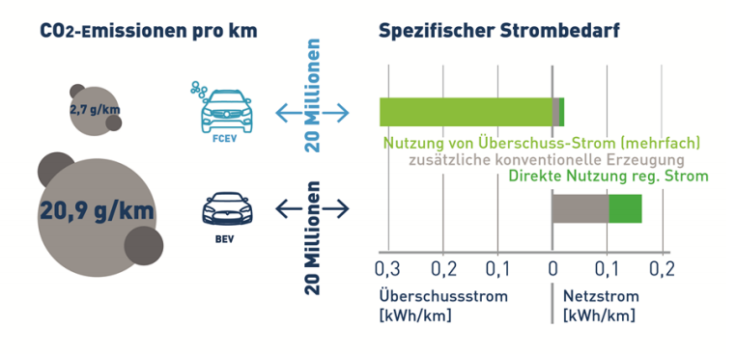
Electric mobility and green house gas CO₂
emissions / km
Specific electricity need
FCEV
Use of electricity excess (multiple)
plus traditional production
direct use of renew. electricity
BEV
Excess electricity
Electricity from grid
Energy used, Energy distribution and CO₂-balance in Germany with
20 mio battery electric vehicles (BEV) or 20 mio fuel cell electric vehicles (FCEV)
source: Forschungszentrum Jülich, Institut für Elektrochemische Verfahrenstechnik 2017

Slide 6


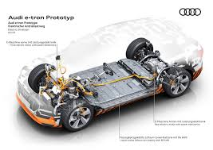
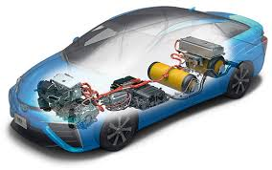
Electro mobility today
Battery and fuel call cars: both electric, but different concepts
Fuel cell technology is based on know-how
Battery technology is based on the use of raw materials

Slide 7
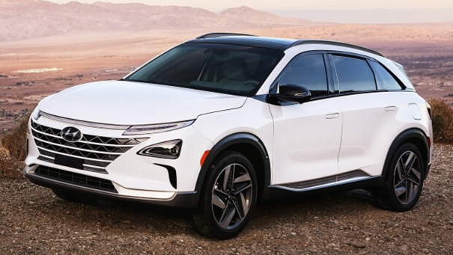
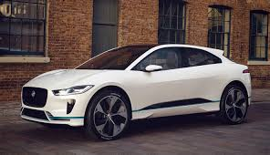
Battery and fuel cell cars
both completely electric, but different features
Hyundai Nexo:
Price: ab 69.000 €
autonomy: 666 km
Refueling time: 3-5 minutes
weight 1,8 t
opex: traditional like ICE
Jaguar I-Pace:
Price: 77.850 €
autonomy: 480 km
Recharging time: 1-10 hours
weight: 2.2 t
opex: slightly better
Raw material: traditional
Recycling: ok
CO₂-problems: no problems
Raw material: intensive
Recycling: very difficult
CO₂-problems non resolved

Slide 8
Comparison of technologies
Battery needs raw materials
Hydrogen needs know-how
Many new prime materials (Li, Co)
Scarcity of raw materials already exists
Lithium batteries can‘t be recycled
Batteries become more expensive
Big environmental impact (mines)
Electricity mix from the grid (fossils?)
Public grids in overload: big impact
Absolute monopolizing exists already
Short autonomy <500 km
Long recharging times (0,5-6 hours)
Bigger weight than ICE
Ideal for small applications
Sensitive to low temperatures
No new raw materials necessary
No scarcity of materials exists
Complete recycling of materials
Fuel cells become cheaper
No environmental impact
Take excess of renew.energy sources
Stabilizes the public grid
No monopolism possible
>700 km autonomy actual
Short refueling time (3-4 minutes)
Less weight than combustion engines
Suited also for big applications
No temperature dependency
Notes:
The battery system is based on new raw materials, which becomes more and more expensive, where we recognize already scarcity on the raw materials which don‘t satisfy the demands. The second hurdle is the monopolism which already has been established by the Chinese on Lithium, on Cobalt and Nickel.
The hydrogen technology doesn‘t require new raw materials, can recycle all the used material and is based on know-how, which can not be monopolized, but can made available everywhere on earth.

Slide 9
We feel the global responsibility
Batteries and raw materials: lessons from the past
Monopolizing is reality: 3 companies = 80% of Lithium market, 5 companies share battery market China owns the most licenses for mining worldwide
Price spiral: Cobalt price increased >3x since 2016 Lithium price increased >2x since 2016
Problematic methods for raw material mining: devastating landscapes
Black energy for mining and purifying in 3rd countries (= reality)
Problematic recycling: if possible, in 3rd countries with connected problems (environment, health, social problems, energy)
“Don‘t believe in hypes …” – we have global responsibility

Slide 10


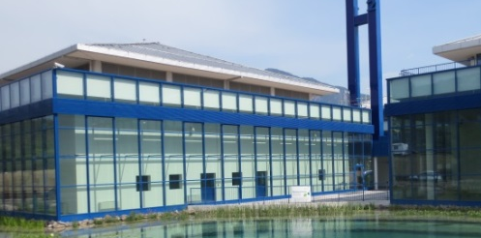
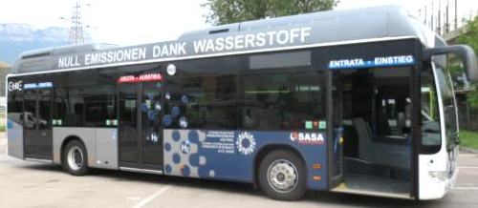
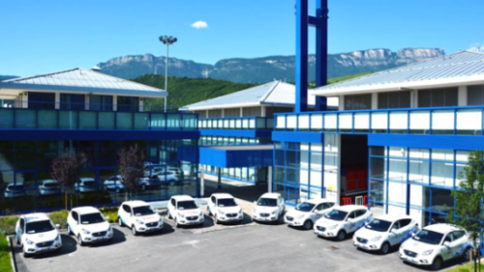
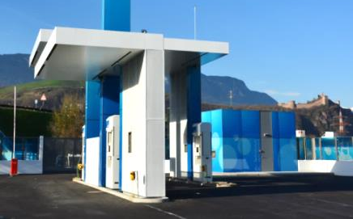
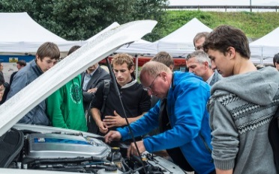
Hydrogen Bolzano
Own production H₂ with electrolysis
Capacity 400 kg H₂ per day using local hydropower
Program: increase production up to 2021
5 H₂-buses in public transport in Bolzano the 6th year
12 new buses acquiring
Program: intra-urban and inter-urban services
H₂-cars with rent-a-car service, fleet H₂ growing (10 ⇒ 15)
Stationary applications in development with local companies
Program: trucks, waste collection, delivering of goods
Program: connecting Italy with central Europe along the TEN-T-axes, IIT as ‘flag ship’
5 refueling stations in Bolzano prov. (30-40 km) until 2021
5 refueling stations along «Green Corridor» (100 km): until 2025
Strategic concepts: regional, national, international
Information, guided visits, education, skill, seminars (>7.000) …
Cooperation: new national decree H₂ 05/11/2018 GU
Program: SME and entrepreneurs as innovators
Notes:
We need concepts and concrete strategies, which can be supported as perspectives for our future by all the political and public structures and decision makers.
Actually are 15-20 company in Südtirol, who already treat the hydrogen sector with its different topics, producing spare parts, developing new concepts and applications etc. there are many professions and activities, gaining benefits of it.
South Tyrol is region with high touristic impact, the Dolomites are recognized as world natural heritage, we are working on projects to reduce the emissions, to protect the citizens and the landscape mainly due to energy saving in buildings, and due to shifting to e-mobility (battery and hydrogen), using mainly the resources of local energies.
It is also important to involve local entrepreneurs, so the development of the technology is extended in the local economic sector creating benefits and well being.

Slide 11
Italy: state of the art
Italy is rich on renewable energy sources
  Wind (costal sites), PV (worldwide 2nd), hydropower (mountains), geothermic …
  very dependent on fossil energies and fuels (>85%)
  Focus on CNG and LNG and respective new trucks
  Interest in H₂-trains (first in 2022 ?) and H₂ Trucks
Italy has deliberated the basis for hydrogen technology
  strategy plan for alternative fuels (16/12/2016 published)
  decree for H₂ refueling station safety (05/11/2018 published)
Interest from public and private sector increases
  Bolzano has the first plant: production, applications, development
  Concrete interest for mobility and energy storage in many regions of Italy: Trento, Veneto, Lombardia, Puglia, Campania, Toscana … :
  Applications on different levels (H₂-train, cars … lack of availability?)
  It is important to involve the private sector in all considerations and further development: industry, SME
Notes:
Italy has all the basic presumptions and opportunities to step concretely into hydrogen technologies: sun, wind, geothermic, hydropower etc.
The national strategic plan has been published in the GU (Gazzetta Ufficiale) 16/12/2016, the decree with the rules for the safety of H2 refueling stations has been published in the GU 4/11/2918.

Slide 12



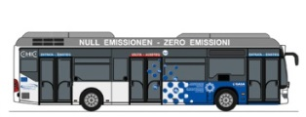


Economic point of view
money flow: H₂ bus
Bus H₂
electricity
Bus operator
expenditure taxes, income personal, jobs
costs-benefit-analysis
Costs for H₂ chain: 100 %
90% remain in region
10% shift to the State
no emission, no pollution, no greenhouse gases
Supports health and life quality of the citizen
reinforcement of local economy: know-how + innovation + jobs
Notes:
The system hydrogen, if applied correctly, carries already today general economic benefits to the territory. If the hydrogen is produced with energy sources from local renewable sources, the whole money remains in the local economic circuit to the benefit of all. No money is transferred abroad to by fossil energies from oil producing countries, which more and more are political instable.
The Province orderes the hydrogen buses, pass it to the bus operator (STA und SASA), spends the money to by the carburant from H₂-Soth Tirol, who has employees and bys the electricity by the provincial electricity company Alperia. All these companies (STA, H₂-South Tyrol and Alperia) have assumed personal, who pay taxes to the province like all the companies do. Alperia transfers also the profit to the province as owner. That is a closed money circuit, because no money flows abroad for buying carburant.
The advantage is already visible, even if the apparatus and the whole technique is still expensive.
The advantages beside the economic ones are already ecological ones: without emissions, without noise, active against climate change but also with positive social effects: new jobs, clean air without asthma etc. but even positive personal and common well being.

Slide 13
Concrete request to EU-Parliament
New taxation model for H₂ production, reason:
  Harmonization on EU level: regulations, not directives !
  H₂-grid ⇒ smart grid: de-taxation and elimination of additional costs
  Using excess of renewable energies for H₂-production increases grid stability
  CO₂ saved is sold to CO₂-trade = cost reduction of production
  Money for carburant remains in local economy circuit and create local taxes
  Make different H₂-taxation used for: mobility, stationary, electricity storage ⇒ avoid double taxation: once for production and once for usage !
Car makers in Europe should not block the initiatives
  Far east producers are strong competitors, will overtake Europeans
  Support European equipment for electrolysis and fuel cell and applications
Politics must clearly indicate the way for the next 20 years
  Industry needs clear indications to go on investment
  No show effects, but strategic procedures to implement the H₂ technology !!

Slide 14

We must find solutions for global problems
Globalism: we stay together under the same roof
Regionalism: the pilaster supporting the roof
Hydrogen initiatives are based on local know-how but produce global effects

Slide 15
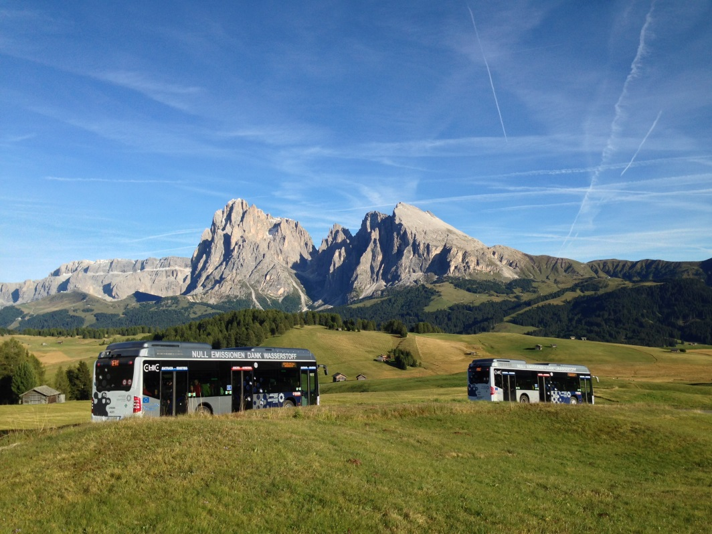


Thank you for the attention
Walter Huber

