Slide 1
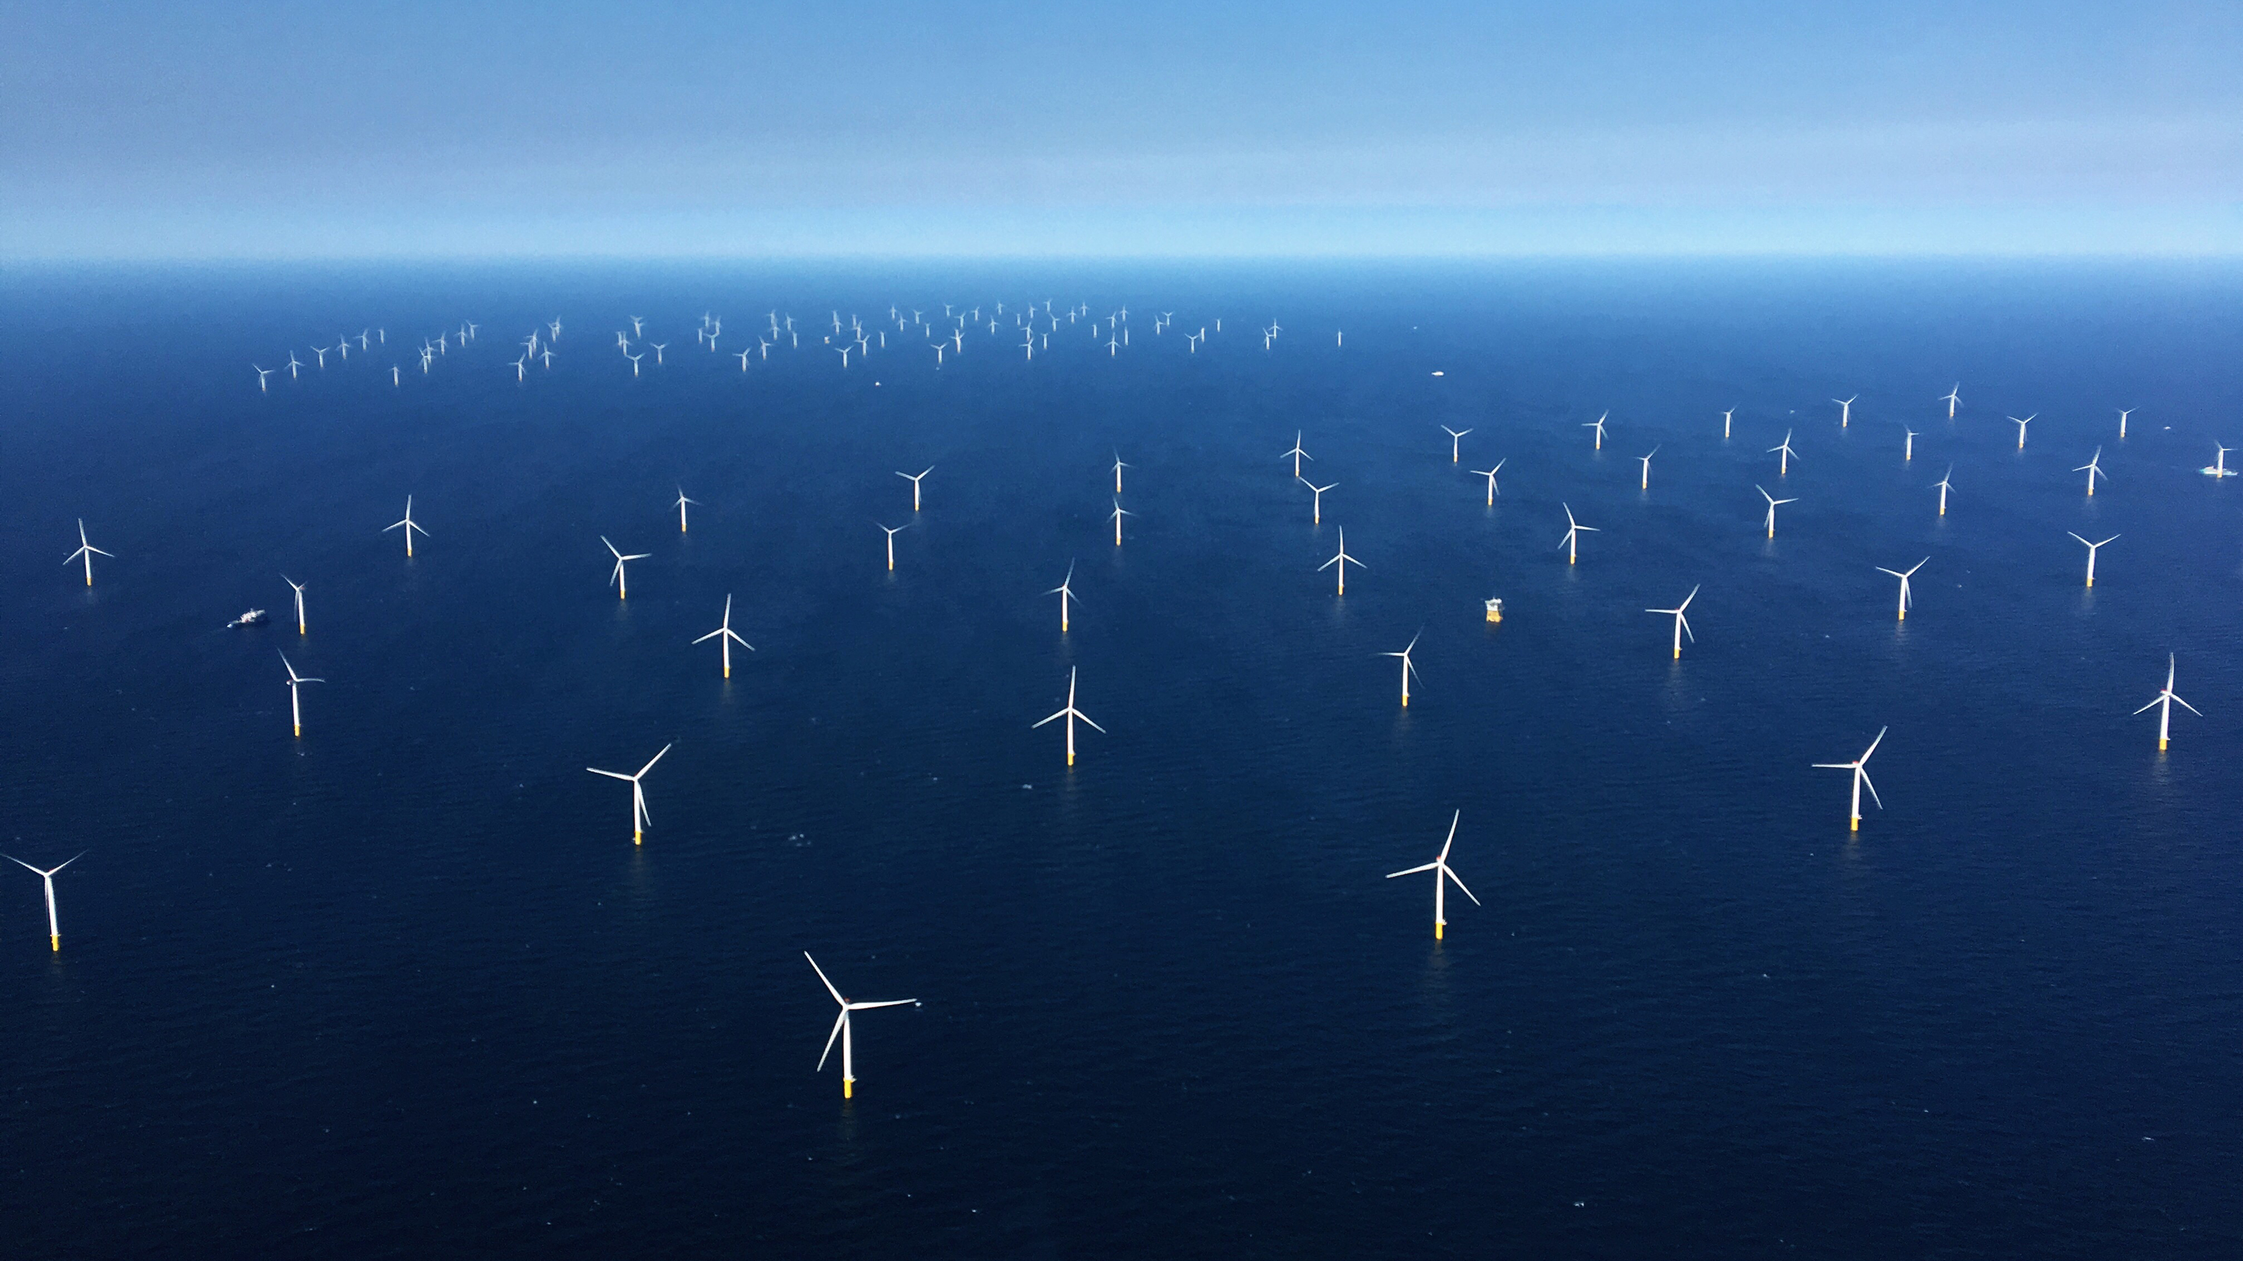
The Changing Blue Economy
Andreea Strachinescu
Head of Unit – DG MARE
European Commission
Directorate General of Maritime Affairs and Fisheries

Slide 2
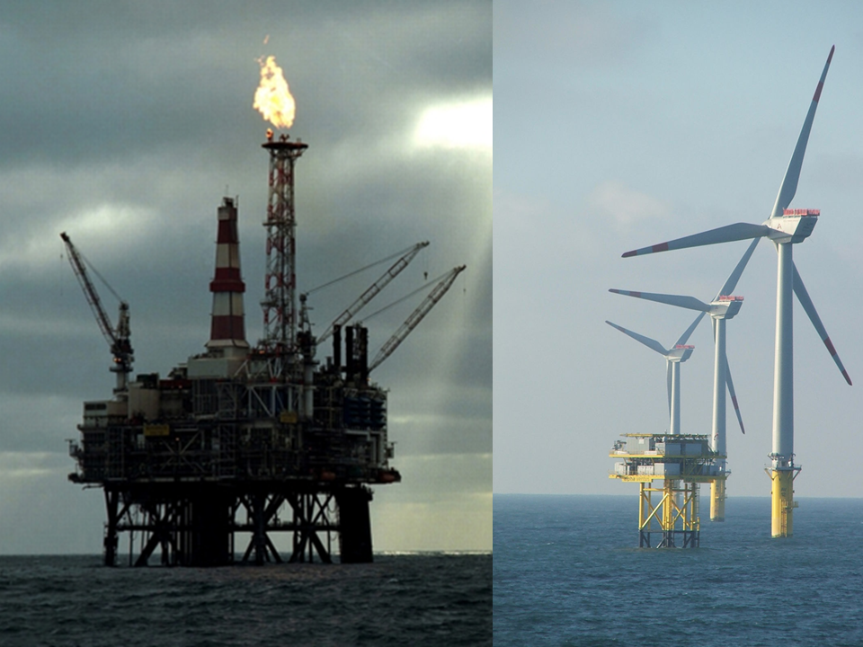
Emerging sectors
shipbuilding
renewable energy
fishing aquaculture
bio-technology
desalination
blue economy
coastal protection
innovative aquaculture
shipping
oil and gas
marine technology
tourism
circular economy

Slide 3
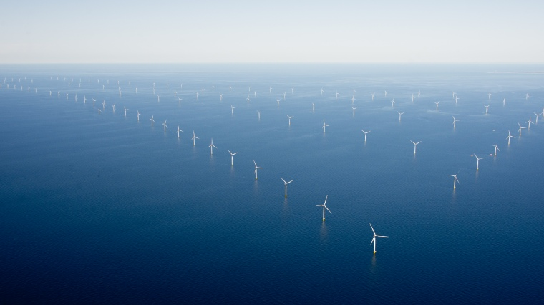
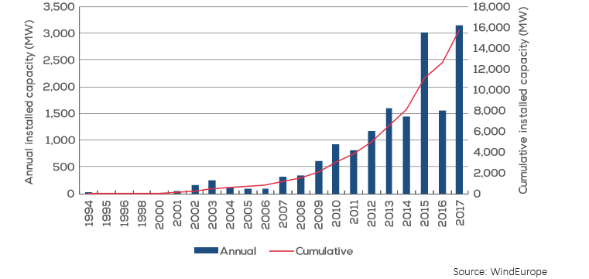
Offshore Wind
85% of installed offshore wind capacity is in Europe;
14% in China;
large potential for further growth
36% more electricity generated than similar turbines onshore

Slide 4
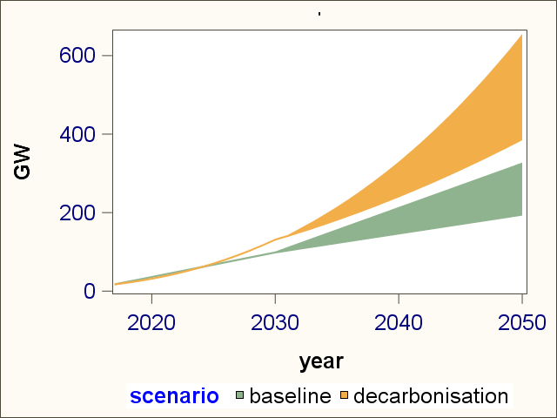
Clean Planet Scenarios – zero carbon by 2050
≈100% increase in electricity consumption
  electric cars
  heat pumps
  digitalisation
at least a quarter generated offshore

Slide 5
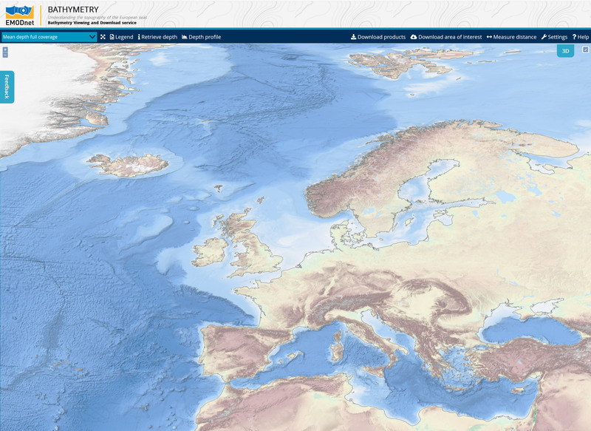

The challenge of deeper waters
narrow continental shelf in Iberian coast and Mediterranean
not feasible for fixed wind turbines

Slide 6
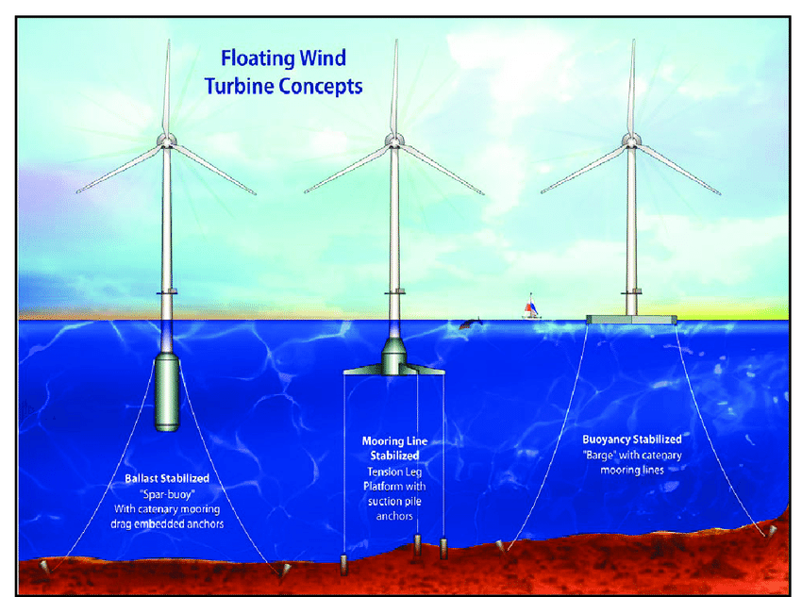
The future is already here floating wind turbines
Wind Farm Name | Country | Capacity | Commissioned
Hywind Scotland | UK | 30 | 2017
Windfloat Atlantic | Portugal | 25 | 2019
Flocan 5 Canary | Spain | 25 | 2020
Nautilus | Spain | 5 | 2020
SeaTwirl S2 | Sweden | 1 | 2020
Kincardine | UK | 49 | 2020
Forthwind Project | UK | 12 | 2020
EFGL | France | 24 | 2021
Groix-Belle-Ile | France | 24 | 2021
PGL Wind Farm | France | 24 | 2021
EolMed | France | 25 | 2021
Katanes Floating Energy Park -Array | UK | 32 | 2022
Hywind Tampen | Norway | 88 | 2022

Slide 7
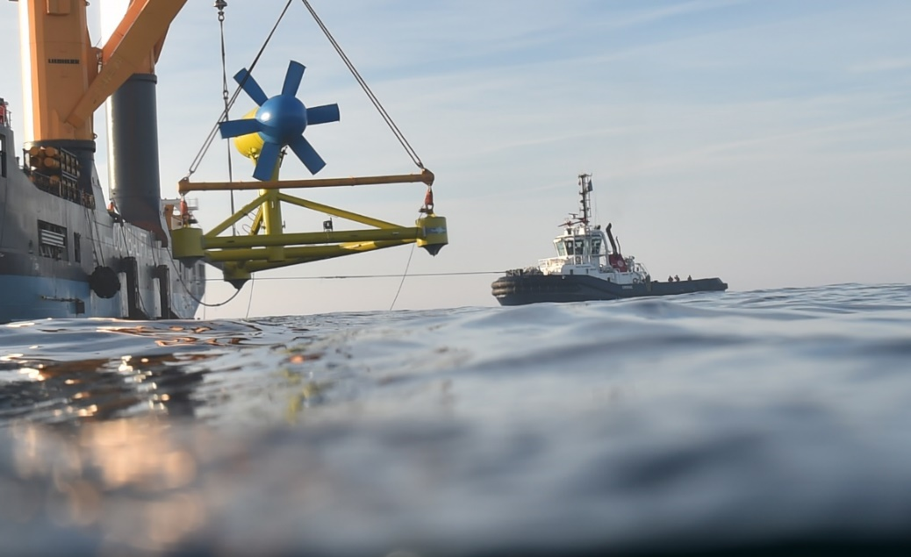
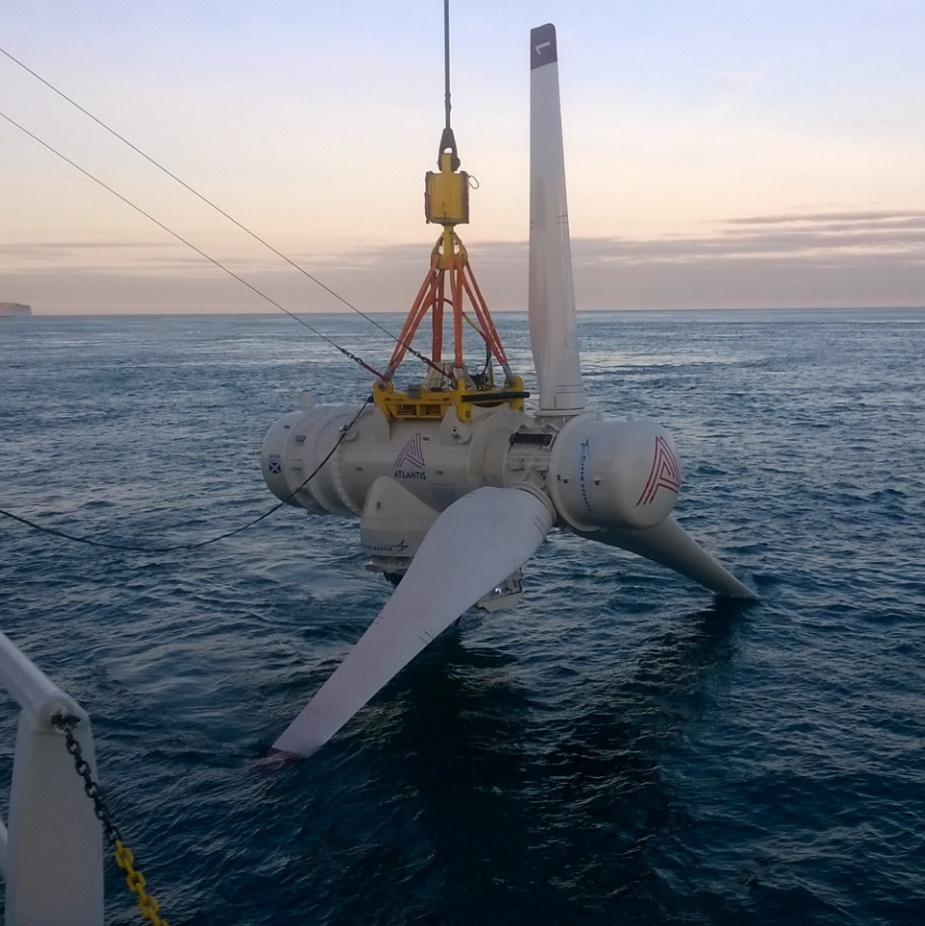
Wave and Tide Power
prototypes in the water and connected to the grid
regular delivery of power complements wind and solar power
can decarbonise islands
Ocean Energy Europe reckon 100 GW in Europe by 2050
© Sabella
© SIMEC Atlantis Energy

Slide 8
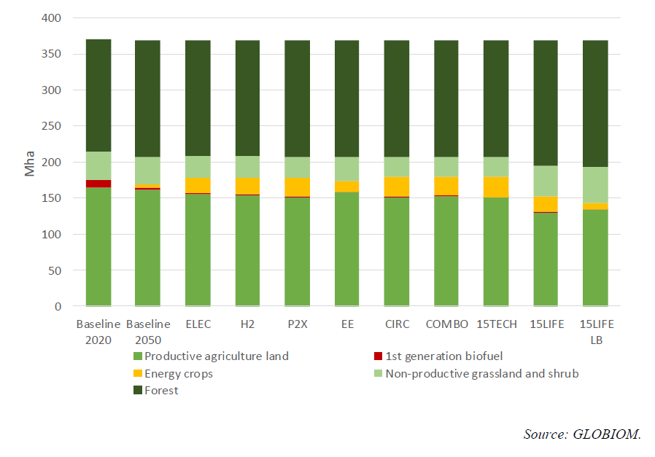
Clean Planet scenarios
“In order to alleviate the multiple demands on the EU's land resources, improving the productivity of aquatic and marine resources will play an eminent role”

Slide 9
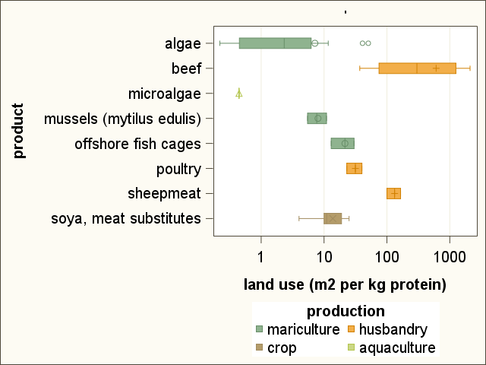
Protein from offshore
reduces pressure on land
lower greenhouse gas emissions
particular promise of low-trophic level species
  shellfish
  algae

Slide 10
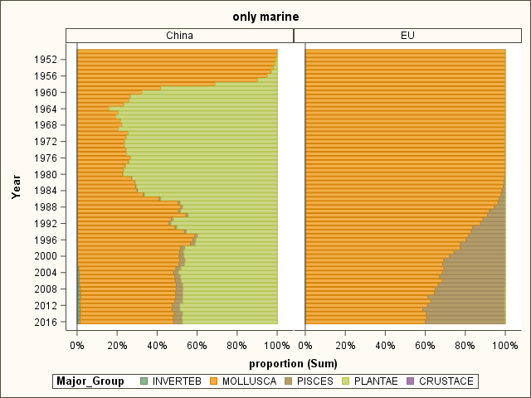
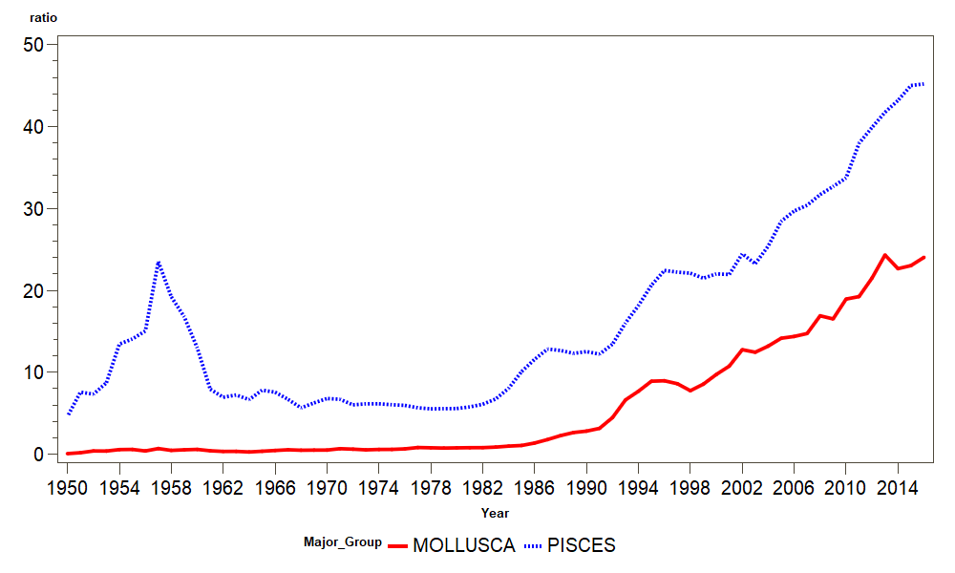

Chinese production orders of magnitude greater than EU with smaller EEZ

Slide 11
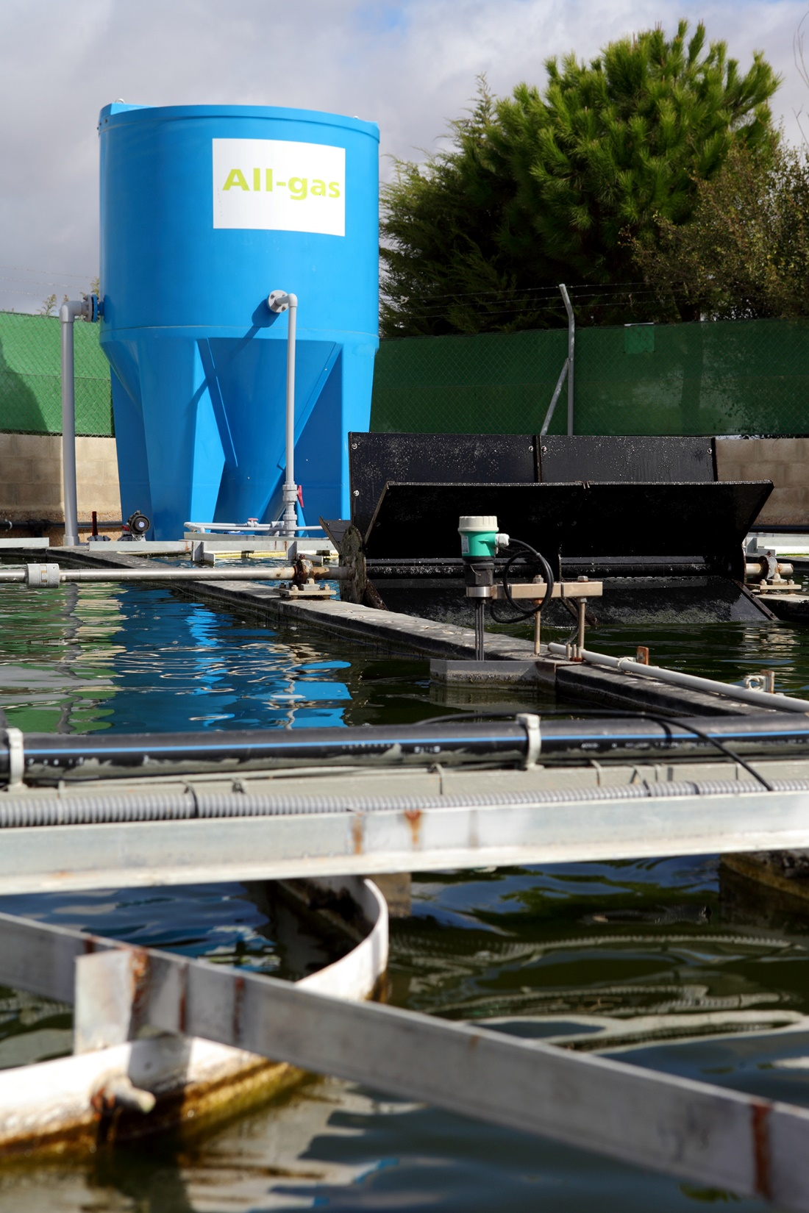

also onshore - Microalgae
can treat waste streams
  wastewater
  CO₂
can produce
  feed for livestock
  biofuel
several research and innovation projects supported by EU

Slide 12
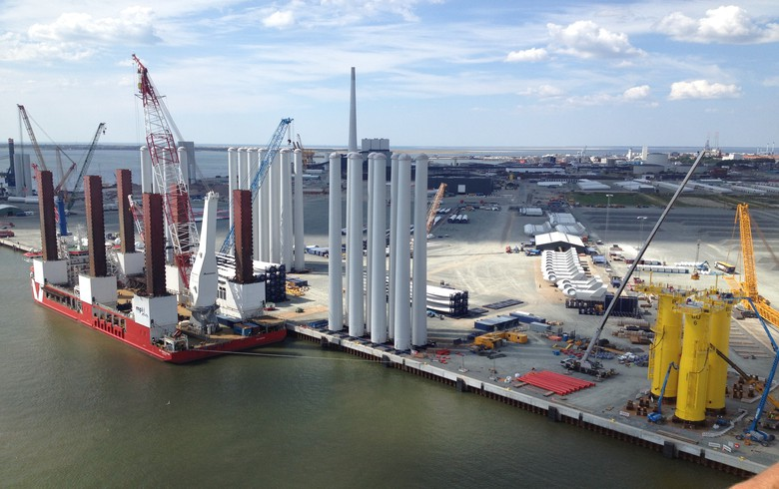
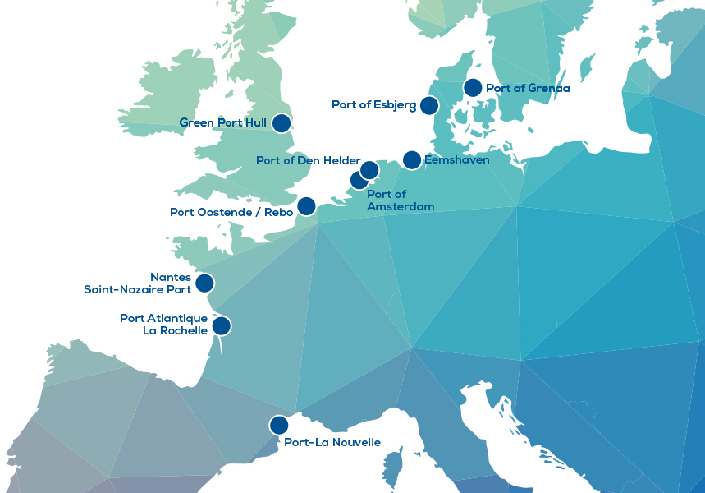
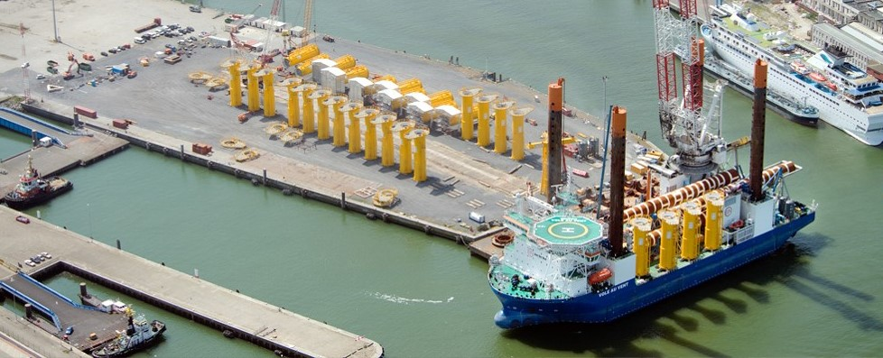
Port as renewable energy hub
Study shows
  Investment in ports reduces costs of electricity 5.3%
  €500 million investment saves €5 billion

Slide 13
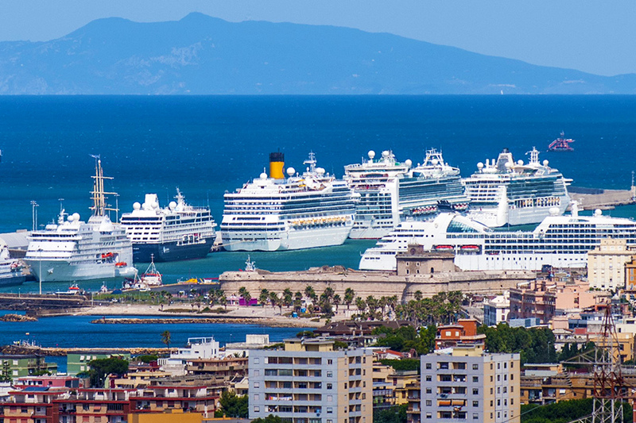
Creating an ecoport - Civitavecchia
Encouraging use of LNG fuel for ships.
  originally looked at shore-side electricity for berthed ships but half emissions were generated during manoeuvring when not connected to the electricity supply
Project of oscillating water column technology in the breakwaters of the port to generate electricity from the waves
Making clothes from plastic generated on board cruise ships and selling them to the passengers.
  Polyethylene terephthalate (PET) from plastic bottles.
  The small company developing this process are already at an advanced stage and have many demonstration products

Slide 14
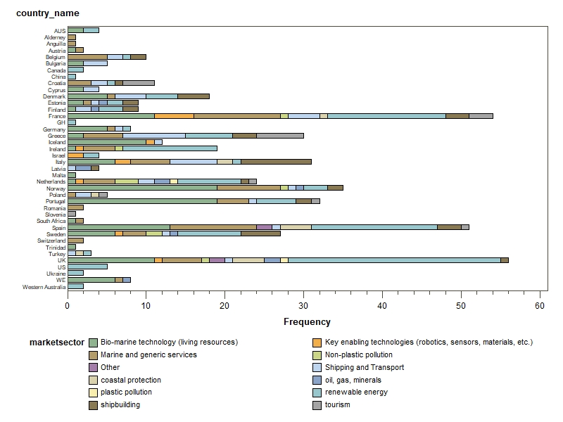
Investments - Projects Pipeline
over 500 projects
ready to take up challenge
investors increasingly interested

Slide 15
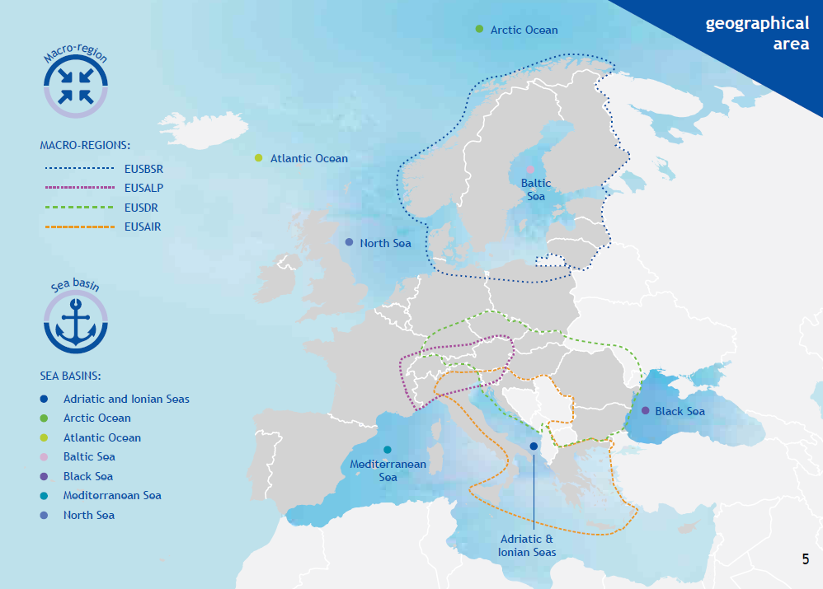
Maritime Regional Cooperation (MRS/SBS)
WestMED Framework for Action

Slide 16
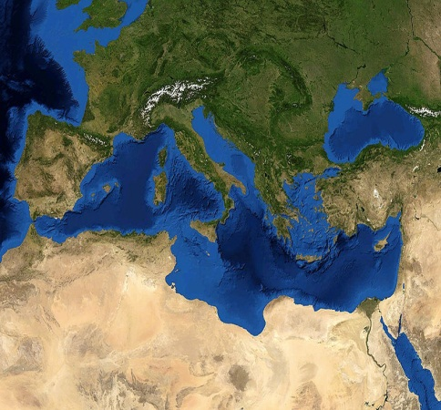
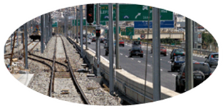
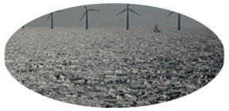

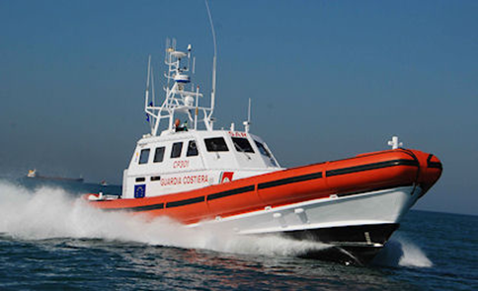


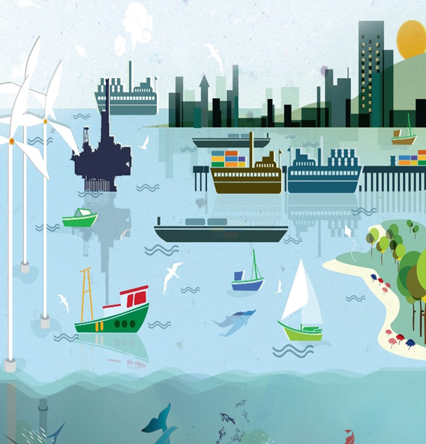
Adriatic Ionian
Pillars
Connecting the Region
WestMED Goals
Blue Growth
Enviromental quality
Safety & Security
Sustainable
Tourism
Maritime Surveillance
Anti-pollution planning
MSP – MPA - ICZM
Maritime transport dev.
Alternative fuels (LNG)
BLUEMED
Maritime Clusters
Education and Training
Sustainable consumption & production
Maritime Governance

Slide 17
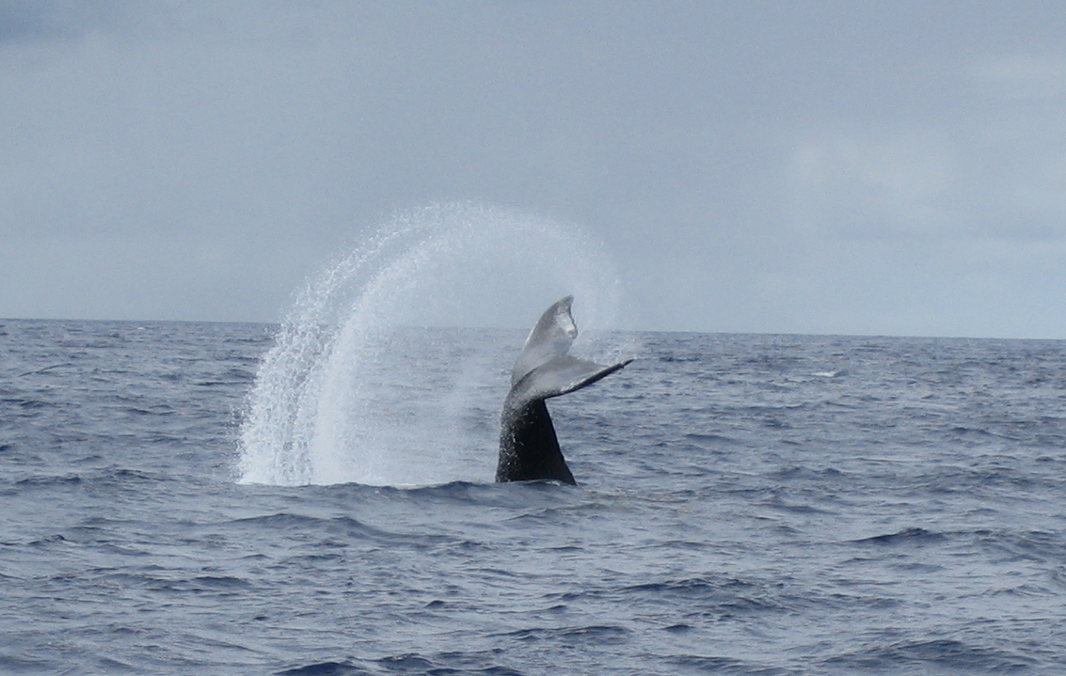


Thank you for your attention !
@stracma
Andreea Strachinescu
Magdalena-Andreea.Strachinescu-Olteanu@ec.europa.eu

